Slide 1
Secure Remote Health Monitoring System
Group 17
Vishwadev Gupta
Asif
Priyanka Raghuvanshi
Project Coordinator :-
Mr. Ankit Verma

Slide 2
CONTENTS
Introduction
Objective
Why Health Monitoring?
Methodology
Technology Used

Slide 3
INTRODUCTION
The real-time medical data collected using wearable medical sensors are transmitted to a diagnostic centre.
The data generated from the sensors are aggregated at this centre and transmitted further to the doctor's personal digital assistant for diagnosis.
The unauthorised access of one's health data may lead to misuse and legal complications while unreliable data transmission or storage may lead to life threatening risk to patients.

Slide 4
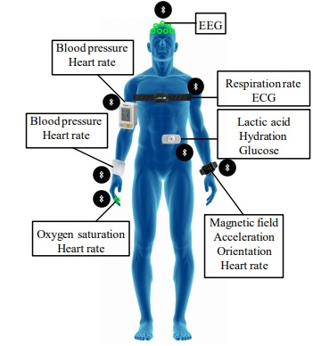
SENSORS

Slide 5
OBJECTIVE
Internet of Things (IoT) is the emerging technology, which contains huge amount of smart object and smart devices connected to the internet for communicating with each other.
These smart devices are used to collect temperature, blood pressure, sugar level, heartbeat, lung and respiration information etc., which are used to evaluate the health condition of the patient.
The final results are displayed on the android device, on web server and also the results are sent to the user through SMS.
This project may play vital role in saving the patient life at emergency time since “Time is life”

Slide 6
Why Health Monitoring ?
You become an observer of your behavior
You can detect changes when they occur
You can detect how much of change
You are more likely to identify which environmental events are related to your health and fitness success

Slide 7
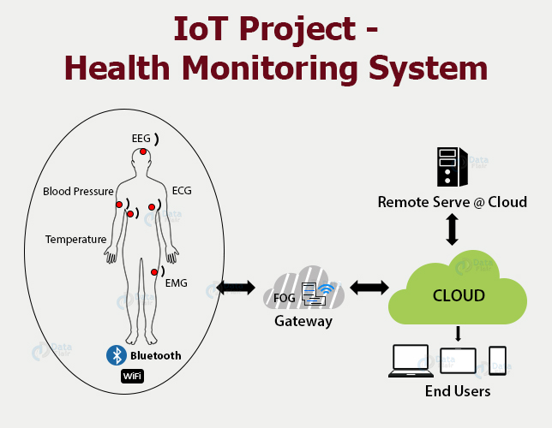
METHODOLOGY

Slide 8
TECHNOLOGY USED
IOT (Internet Of Things) :
Internet of Things (IoT) is usually referred to as the physical one, which is connected to the world of the Internet and has limited storage and processing capabilities.
The IoT has also proven to be the benchmark for medical systems in which smart objects are used to continuously monitor patients for specific diseases.

Slide 9
CLOUD COMPUTING
Cloud computing has almost unlimited processing power and storage capacity. While this is a more advanced technology for solving technical problems in the IoT, data mining is an intelligent technology used to inspect huge volumes of records and extract new information.
It can be used to make specific decisions, estimates, and predictions using a variety of machine learning algorithms.

Slide 10
THANK YOU ☺

